Slide 1


Slide 2
Overview
Spring Security is a framework that provides authentication, authorization, and protection against common attacks.
With first class support for securing both imperative and reactive applications, it is the de-facto standard for securing Spring-based applications.
it is the standard for securing Spring-based applications.

Slide 3
You will learn how to ...
Secure Spring MVC Web Apps
Develop login pages (default and custom)
Defines users and roles with simple authentication
Protect URLs based on roles
Use JSP tags to hide/show content based on roles
Store users, password and roles in DB
(plain text-> encrypted)

Slide 4
Spring Security Model
Spring Security defines framework for security
Implemented Servlet filters in the background
Two methof of securing a Web App:
Declarative
Programmatic (link)

Slide 5
Architecture
This section discusses Spring Security’s high level architecture within Servlet based applications.
We build on this high level understanding within Authentication, Authorization, Protection Against Exploits.
Servlets Filters are used to pre-process/ post-process web requests
Servlet Filters can route web requests based on security Logic
Spring provides a bulk of security functinality with servlet filters.

Slide 6
Architecture Continue..

Slide 7
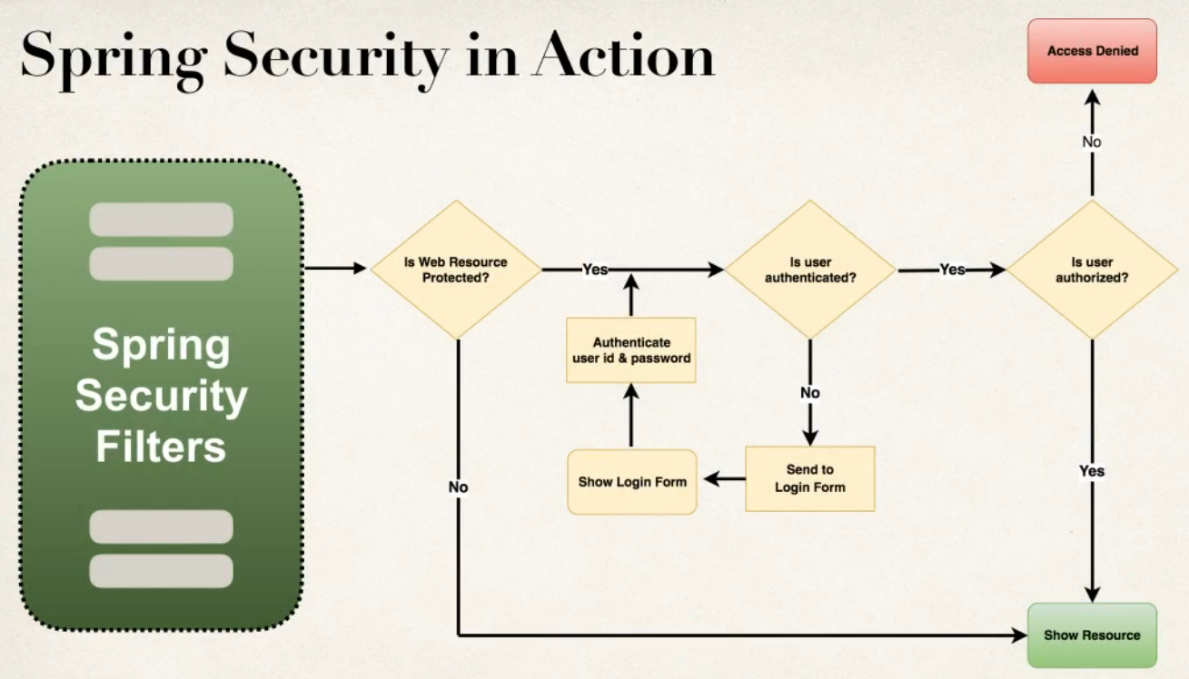
Does User have autohrized role?
Check if user id and passwords are valid

Slide 8
Security Concpets
Authentications
Check user id and password with credentials stored in app/db
Authorization
Check to see if user has an authorize role

Slide 9
Declarative Security
Define application’s security constraints in configuration
All java config (@Configuration, no xml)
Or Spring XML config
Provides separation of concerns between application code and security.

Slide 10
Programmatic Security
Spring Security provides an API for custom application coding
Provides greater customization for specific app requirements

Slide 11
Different Login Methods
HTTP Basic Authentication
Default Login Form
Spring Security provides a default login form
Custom Login Form
your own look-and-feel, HTML+CSS

Slide 12
Authentication & Authorization
In-memory
JDBC
LDAP
Custom / Pluggable
others...

Slide 13
Declarative Security Versus Programmatic Security
Two basic approaches to implementing security are:
Programmatic security, in which you embed explicit security calls directly into your code,
Declarative security, in which you specify security policies using deployment descriptors and configuration files. (back)

Slide 14
Reactive vs. imperative programming with Java
Reactive and imperative programming paradigms are fundamentally different. Java is primarily an imperative language, in that it's solely focused on achieving the final result by pulling an event off of a queue. Reactive programming registers a callback and the framework is responsible for calling that callback correctly.
In the imperative paradigm, the code is executed based on the statements that detail every single step that the program has to do before the task can be completed. Data is being pulled in imperative programming while it's being pushed in reactive.
Statements are used in the imperative paradigm to change a program's state. It lists the commands that the computer needs to perform in order to complete the task. This defines how the program needs to operate. The code is only executed in order statement by statement.
Reactive programming is different because it relies entirely on asynchronous data streams. These streams can be changed, created or combined on the fly. The execution is not done in order as it’s no longer based on arrays but on streams.
In most implementations, both reactive and imperative paradigms are required. Writing business logic is easier in imperative style while the reactive paradigm is better suited to event handling.
Developers can thus write the app's code in the imperative style but use the reactive style to perform select functions.(Back)

Slide 15

HELLO!
I am Vishal Thakur
I am here because I love to give presentations.
You can find me at https://javawithvishal.com

Slide 16
THANKS!
Any questions?
You can find me at
@98269-52872 & vishalthakur107@gmail.com

